Slide 1
Theme 7 - Polling Station
Guidance Plan:
Under the law the DEO has the statutory responsibility of providing adequate no. of Polling Stations for the constituencies falling within the district. The DEO has to follow the protocols and norms specified by ECI for setting up of Polling Stations. The statutory provisions and the ECI instructions have been brought out in the slides (slides 2 to 5)
The exercise of publishing a draft list of PSs, inviting claims/objection with regard to the draft list, consultation with political parties and the manner of seeking ECI approval for the PSs have been explained in slides 9, 10, 11, 15,16, 17, 18.
DEO to ensure physical verification of the Polling Stations and put in place necessary infrastructure in PS to meet the Assured Minimum Facilities specified by ECI to facilitate smooth voting and hassle-free experience for voters (slides 20 to 27).
The slides also cover the guidelines for setting up of PS for polling, the required arrangements on the poll day, including the role and functions of various election related personnel and security officials on the poll day in and around the PS.
The norms for setting up PSs and rationalization of PS have been explained in detail. It should be noted that there are several ECI instructions to ensure smooth voting experience for the voters. All these instructions should be individually and carefully studied for effective implementation at the field level.
The slides also cover the special arrangements required at PS to take care of needs of PwD electors, senior citizens and women.
The related points in DOs and DON’Ts, Checklists, etc., and the relevant chapters of the RO Handbook would be the reference points and study material for this topic.

Slide 2
Legal Provision
S 25 RPA 1951 provides as under:
“Provision of polling stations for constituencies.—The district election officer shall, with the previous approval of the Election Commission, provide a sufficient number of polling stations for every constituency the whole or greater part of which lies within his jurisdiction, and shall publish, in such manner as the Election Commission may direct, a list showing the polling stations so provided and the polling areas or groups of voters for which they have respectively been provided.”

Slide 3
Establishment
Polling stations to be provided by DEO for clearly well-demarcated polling areas
Do’s:
As far as possible PS to be set up permanently in government / semi-government buildings or institutions aided by the government, like schools or colleges, community centers, village chaupals, etc.
In exceptional circumstances with prior approval of ECI a PS can be setup in a temporary structure
Number of Electors in a polling station should not exceed 1500 electors (As per latest ECI instructions).
However, for every village in a remote or sparsely populated or hilly area, having more than 300 voters and having a suitable building for setting up a PS, a polling station must be provided.
In areas inhabited by weaker/vulnerable sections of society, Polling Stations for a fewer number of electors can also be provided.
Contd…

Slide 4
Establishment – contd.
Do’s (contd.):
Location of PS should be chosen in such a manner that ordinarily, no voter is required to travel more than 2 kilometers for casting his/her vote.
Ordinarily PS should be set up within the Polling Area. Only in extraordinary conditions due to the non-availability of a suitable building, it can be set up in an adjoining area taking into consideration that electors are not required to travel more than 2 KM.
Polling Station should be on the ground floor or the floor directly connected to the road (in hilly areas) to facilitate aged and PwDs.
Contd…

Slide 5
Establishment – contd.
Don’ts:
No area of any constituency to be left out while demarcating polling stations.
PS not to be located in police stations, hospitals, temples, or other places having religious significance.
As far as practicable, don’t locate PS, in private buildings/premises. However, in unavoidable circumstances, private premises/building can be used under S 160 RPA 1951.
As far as possible, in a single building not more than 4 Polling Stations shall be set up in case of Urban areas and not more than 2 in case of Rural Areas.
Contd…

Slide 6
Rationalisation of Polling Stations
Rationalization of polling stations is a very important activity undertaken as part of pre-revision activity before every SSR:
Physical verification:
To be done after 100% physical verification of the polling station locations and the relevant parts of the electoral rolls.
Overall responsibility for the work of rationalization of polling stations rests with the district election officer. A nodal officer may be appointed for verification and rationalization of the polling stations.
Due consideration should be given to the existence of obstructions like hills, forests, rivers, jungles, etc. For instance, no polling area should contain villages on either side of a big river; but where the village itself is divided by a river or stream it should not be split up for polling purpose unless there are special reasons.
Contd…

Slide 7
Rationalisation of Polling Stations – contd.
Key parameters to be checked during 100% physical verification-
Whether polling station area has been correctly and fully described in the existing polling station list and situated inside/outside the polling area;
Whether voters have to cross river/canals/ravines etc, to reach the polling station or a distance of more than 2 kms to reach the polling station;
Whether the building is dilapidated or dangerous and location has more than 2 polling stations in rural areas or more than 4 polling stations in urban areas;
Whether the minimum area of polling station room is 20 sq. meters and whether it is having two doors or is on 1st floor or above;
Whether the polling station is in a private building/police station/hospital/ dharamshala/temple or a religious place;
Whether office of any political party is situated within 200 meters from polling station location;
Whether the building is having AMF.
Whether in localities predominately inhabited by minorities, weaker sections of society like scheduled caste/tribes, the polling stations are located in such a manner that such communities are prevented from reaching the polling station and casting their votes.
Contd…

Slide 8
Rationalisation of Polling Stations – contd.
Criteria for setting up a new polling station during rationalization
Optimum number of electors to be assigned to a polling station shall be as per extant instructions of the commission in this regard.
All existing auxiliary PS should be converted into main polling stations by dividing the electoral part.
New polling station may be proposed if a village has more than 300 electors and a suitable government building is available for the ps.
If a new colony with a number of dwelling units has cropped up, then new polling station may be created giving due regard to the compactness of polling area.
New/separate polling station may be created in localities predominately inhabited by minorities / weaker sections of society like scheduled caste / scheduled tribes irrespective of number of electors.
Contd…

Slide 9
Rationalisation of Polling Stations – contd.
Consultation with political parties
All rationalization proposals should be discussed with the representatives of recognized political parties, and all their complaints and suggestions should be taken on record and duly disposed of.
Control table updation
Necessary updation of control tables must be done in the ERONET as per the standard procedure of the commission.
Sending proposals for ECI approval
Proposals to be sent to the commission for approval of the rationalization of polling stations along with report of the DEO on the process followed in the rationalization of polling stations, mentioning all proposals received from political parties and also whether the proposals were accepted or not. If the proposals of political parties are not accepted the report should mention reasons for not accepting them.
The proposal should have copies of the minutes of meeting with political parties mentioning the proposals not accepted along with reasons.

Slide 10
Overview of general principles /procedure for setting up PS – annual pre-revision exercise
Optimum number of polling stations is determined by dividing the total elector population of the constituency by 1000 (Average Electors) and then working out the actual numbers based on various parameters viz; Electorate size, Physical barriers, buildings availability, vulnerable sections, etc.
Draft list of PS, along with various maps is published in the language of the electoral roll for the constituency, for general information, inviting objections and suggestions from the public, by a specified date, allowing a period of not less than seven days from the date of publication of the draft list of PS.
Contd…

Slide 11
Overview of general principles /procedure for setting up PS – annual pre-revision exercise – special pre-election steps - Verification – contd.
The following instructions are to be carried out strictly and scrupulously to assess and make inventory of the polling station locations in the States / UTs
The DEO and the RO shall do an advance exercise well before the election to get the conditions of the polling stations physically verified by the field officials. The Sector Officers should visit each Polling Station / location within his / her jurisdiction to assess whether it is use worthy. The RO should physically verify 10% of the polling stations / locations.
Contd…

Slide 12
Overview of general principles /procedure for setting up PS – annual pre-revision exercise – special pre-election steps - Verification – contd.
Physical verification report, remedial action and action taken report and providing AMF at PS:
The final CD/DVD should be labelled properly, clearly mentioning District Name, AC Name & number and PS location, number and name, so that the problem of identification does not arise.
The DEO should initiate remedial measures, where required, on the basis of the above physical verification reports and send an ‘action taken report’ to the CEO, at the earliest. In the process of ensuring AMF at the polling stations, the DEO should make optimal use of funds available under the relevant election expenditure budget head and / or explore the possibilities of synergising the objective of AMF at polling station with any of the suitable ongoing schemes / projects, provided the activity is covered under the parameters of such schemes or dovetail the requirements of AMF with ongoing / existing schemes of the local bodies within the district as most of the polling stations are normally located in the government / local body school building and other government buildings.
Contd…

Slide 13
Overview of general principles /procedure for setting up PS – annual pre-revision exercise – special pre-election steps - Verification – contd.
Model PS and Special PS (operated by women, PwD, youth, etc.), territorial teams to visit PS to document the condition/amenities through videography:
The CEOs should plan for setting up some model polling stations at the metropolitan cities / state capitals / major cities of the states. The thrust of such initiative should be more on voter friendly environment and superfluity should be avoided.
The DEOs should form territorial teams / squads to visit each and every polling station location and prepare a video documentation on the condition of polling station and existing amenities and a feedback on action to be taken for each such polling station. During videography, the following points should be covered:
Access / entry of the polling station locations;
Surroundings of the polling station;
Existence of boundary wall; if any.
Building area, open space, number of rooms;
Actual location of polling station within the premises/campus;
Availability / location of civic amenities like drinking water, toilets, electricity, ramp, furniture, shades etc.
Contd…

Slide 14
Overview of general principles /procedure for setting up PS – annual pre-revision exercise – special pre-election steps - Verification – contd.
Particulars to be inserted in videography of visit of PS:
At the beginning of videography, the following should be displayed on a card board and captured on camera, as well as spelt out in voice-over:
DISTRICT NAME;
AC NUMBER & NAME;
PS LOCATION NUMBER & NAME;
PS NUMBER AND ADDRESS.

Slide 15
Procedure for setting up PS – draft list – requirement of consultation –record of consultations – format for seeking ECI approval – publication of final list by DEO - contd. (S 25 RPA 1951 & ECI Instructions) – contd.
Consultations on draft list of PS and submission of proposal for ECI approval:
Wide consultations should be held on the draft list of PS, including with the political parties and legislators.
Record of consultations to be maintained for later reference.
After due deliberations necessary amendments shall be made to the draft list and final list of Polling Stations shall be prepared by the DEO concerned.
Commission’s approval is sought on this final list of polling stations. Certificate prescribed by the Commission and Scrutiny sheet to be submitted along with the proposal.
Consequent to approval by the Commission, final list of polling stations is published by the DEO.
Contd…

Slide 16
Procedure for setting up of PS
– format of proposed list of PS for ECI approval – contd.
Contd…

Slide 17
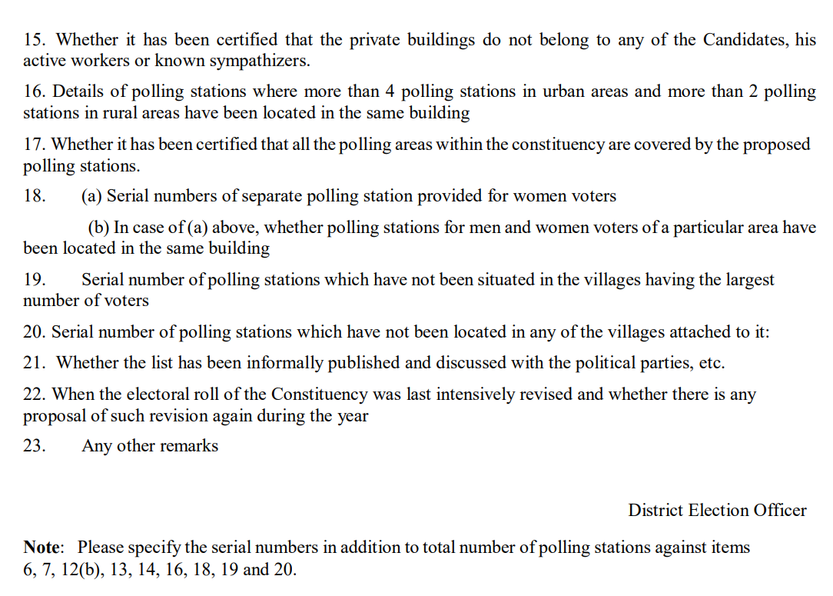
Procedure for setting up PS – Format of Scrutiny Sheet – contd.
Contd…

Slide 18
Procedure for setting up PS – Format of Certificate of DEO - contd
Contd…

Slide 19
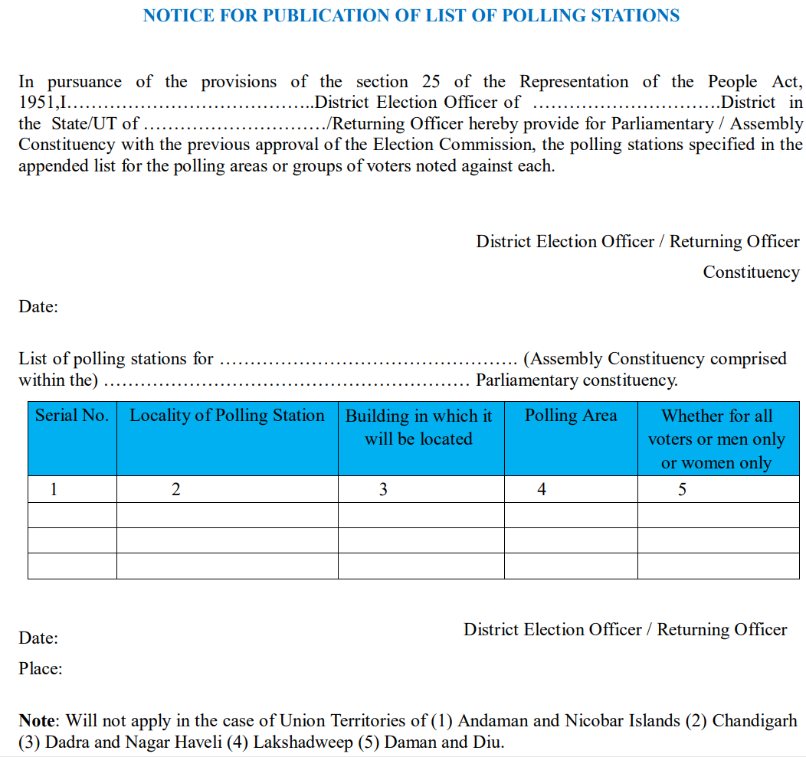
Procedure for setting up PS – Format of Public Notice for publication of the approved list of PS – contd.
Contd…

Slide 20
Further Changes/Modifications in PS List
Changes in list of PS subsequent to publication - procedure:
Only under extraordinary circumstances changes shall be made to the final list of Polling Stations after its publication.
In all such cases a written approval of the commission is a must.
Any change in the nomenclature of a PS consequent to the change in name of the building, does not require Commission’s approval.
The political parties/candidates must be informed about any such change in writing.

Slide 21
Auxiliary Polling Station
Creation of Auxiliary Polling Station – preparation of Marked Copy of ER for use in main PS and auxiliary PS:
Where the maximum number of electors in a polling area exceeds beyond the limit prescribed by the Election Commission, auxiliary polling station(s) is provided bifurcating /trifurcating the existing polling station, preferably in the same PS Location.
The part number of auxiliary polling station(s) is indicated by adding a suffix to the serial number of the main polling station, like '100', '100A/1', '100A/2’, and so on.
Wherever Auxiliary PS are created by bifurcating any part of ER after final publication, the following points should be ensured:
on one of the copies to be used as Marked Copy of ER in the Main Polling Station, the entries assigned to the Auxiliary Polling Station should be deleted by putting cross (X) mark by hand with ink across the relevant pages/part of the page
in the Marked Copy of ER to be used at the Auxiliary polling station, the alphabet “A” shall be appended to the Part number on the Part header and the entries assigned to the Main polling station should be deleted by putting cross (X) mark by hand with ink across the relevant pages/part of the page.

Slide 22
Types of special Polling Stations:
Polling Stations for voters of Vulnerable Sections
Polling Stations for voters suffering from leprosy
Separate Polling Stations for men and women
Special Polling Stations for PwD
Mobile Polling Stations
Temporary Polling Stations
Model Polling Stations

Slide 23
Assured Minimum Facilities (AMF)
Commission envisages a pleasant experience for an elector at a polling station on the day of Poll and as such desires some Assured Minimum Facilities (AMF) at every PS.
Provision for ramp-
A ramp of slope 1:12 should be provided at the polling station to facilitate the PwD (Persons with Disabilities) voters.
Provision for drinking water –
Proper arrangement for drinking water facilities at the polling station(s)
Adequate Furniture –
Proper and adequate furniture to be provided at each PS.
Medical Kit –
Medical Kit containing Paracetamol medicine & items like gauze pads (4x4 inches)/ large gauze pads/ adhesive bandages/ rolling bandage/ ORS/triangular bandages/ wound cleaning agent/scissors / blanket/ tweezers/ adhesive tape/ latex gloves / resuscitation equipment etc., along with a medical attendant should be made available at each polling station for emergency use of voters.
Contd…

Slide 24
Assured Minimum Facilities –contd.
Proper lighting/Electricity arrangements:
Ensure proper lighting arrangements at the Polling Stations. If power connection is not there, alternative arrangements should be made by hiring generator sets, etc.
Help Desk –
A help desk should be set up for the assistance of the voters, including the issuance of voter slips at a prominent spot and manned by a Booth Level Officer (BLO) who should be supplied with an alphabetical list of electors.
Proper Signage –
Proper Signage should be put at the polling station locations for guidance of the voters about the route/layout of the location and facilities available.
Contd…

Slide 25
Assured Minimum Facilities – contd.
Toilets –
Separate toilets for men and women. One employee or a daily wage-earner shall be deployed to keep the toilet clean throughout the day.
Shade in Polling Station –
Tented arrangements for shade with appropriate dimensions shall be made available at each polling station to protect voters from hot sun or rain.
Volunteers –
Volunteers with age less than 18 years, from NCC/NSS/Scout & Guides/ Chunavi Pathshala should be deployed to manage the voters’ queue, and assist the PwD voters.
Contd…

Slide 26
Assured Minimum Facilities –contd.
Provision for Crèche for children –
Proper arrangements for a crèche at each polling station for children accompanying the electors with a trained attendant shall be made at each PS.
Provision for Pick and Drop Facility:
Persons with Visual and Locomotive Disabilities and infirm voters with impaired movement should be provided with public transport. If public transport is not available, private vehicles should be hired for the purpose.
Contd…

Slide 27
Assured Minimum Facilities –contd.
Queue Management:
There should be three queues at the polling station: one for male voters, one for female voters and another for senior citizens and PWD electors. As per present practice, one male elector should be allowed to vote per two female electors. Preference should be given to senior citizens and PWD electors.
Display of Voter Facilitation Posters:
As per present practice, there are four posters to be displayed at the polling station to disseminate information to the electors. These four posters should be numbered 1/4, 2 /4, 3/4 and 4/4 respectively.

Slide 28
Critical Polling Stations
Critical Polling Stations are identified as per ECI guidelines with a view to implement additional measures for ensuring free and fair conduct of Poll.
Norms for identifying critical PS as specified by ECI are:
incidents of violence,
intimidation to voters especially of weaker and vulnerable sections,
abnormally high voting in favour of a particular candidate in the last general election i.e. PS where percentage of poll recorded is more than 90% and out of these more than 75% of votes have been recorded in favour of one candidate.
Contd…

Slide 29
Critical Polling Stations – contd.
Following categories of PSs shall additionally be identified as critical polling stations:
PS with high percentage of Non-EPIC voters.
PS having a high proportion of absent/missing voters with reference to the average proportion of such voters in the Constituency.
PS where there were re-polls during the past elections owing to reported electoral malpractices
PS that witnessed any sort of electoral violence.
Contd…

Slide 30
Critical Polling Stations – contd.
Special Measures to be implemented at Critical Polling Stations:
Mandatory deployment of Central Para-military Force.
Mandatory deployment of a micro-observer in consultation with the General Observer.
List of such PSs be given to Commanding/Assisting Commanding Officer of CPF to keep an eye on such PS.
Digital camera or video camera in the critical polling station.
Webcasting of all Critical Polling Stations to be done.
NB: The exact measures (out of the above list) to be decided with due regard to the latest instructions of ECI in this behalf

Slide 31
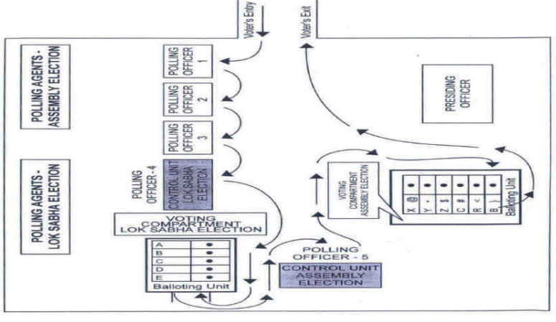
Polling station layouts for single and simultaneous elections:

Slide 32
Polling Station Arrangements
Area:
As far as practicable the minimum area of a Polling Station should not be less than 20 Sq.mt.
Entrance & Exit:
Generally, PS has only one door as shown in the layout.
Ideally, there should be a separate entrance and exit for voters in a polling station.
Even if, there is only one door in the PS, a separate entrance and exit can be provided with the help of bamboo and ropes in the middle of the doorway.
Contd…

Slide 33
Polling Station Arrangements – contd.
Voting Compartment:
Voters have to vote in secrecy and for this purpose, the ballot units & VVPAT are required to be kept in voting compartment.
Voting compartment has three sides covered.
The voting compartments shall be made only of corrugated plastic sheet (flex-board) of steel grey color, which is opaque and reusable.
The Voting Compartment shall be in three folds, each fold having dimensions of 24” X 24” X30” (Length X Width X Height).
Contd…

Slide 34
Polling Station Arrangements – contd.
The interconnecting cable of BU/VVPAT should be so routed that it does not obstruct the movement of voters inside the PS.
The entire length of the cable should be visible.
Under no circumstances cable be concealed under the cloth or under the table.
The ballot unit and VVPAT is to be placed inside the voting compartment on a table.
There should not be more than 6 inches gap between BU and VVPAT.
Contd…

Slide 35
Polling Station: CU – VVPAT – BU connections
Contd…

Slide 36
Polling Station Arrangements – contd.
Sitting Arrangement:
Polling Officials:
As per schematic slide.
Polling team should not be in a position to see the voter while s(he) records the vote.
Polling Agents:
Will be seated in such a way that they can see the face of an elector when s(he) enters the polling station for identification.
They should also be able to see the entire operation at the Presiding Officer’s table/the table of the third Polling Officer, where the control unit is kept
But, they should not be in a position to see the voter while actually casting the vote.
Contd…

Slide 37
Polling Station Arrangements – contd.
Preference in sitting Arrangement for Polling Agents:
Candidates of recognized National Political Parties;
Candidates of recognized State Political Parties;
Candidates of recognized State Political Parties of other states;
Candidates of Registered Unrecognized Political Parties;
Independent Candidates.
Contd…

Slide 38
Polling Station Arrangements – Outside PS
Material/document to be displayed outside each polling station:
A notice specifying the polling area the electors of which are entitled to vote at the polling station and when the polling area has more than one polling station, the particulars of the electors so entitled.
A copy of the list of contesting candidates.
A poster showing DO’s & DON’Ts for voters
A poster showing ‘how to vote’ and list of notified ID documents

