Slide 1
Theme – 8B: Postal Ballot
Guidance Plan:
S 59 RPA , 1951 r/w R 16 COER 1961, lays down the general norm that the voting by all electors at an election would normally be in person at the polling station provided for that elector under S 25 RPA 1951 or as the case may be, at the place of polling fixed under S 29 RPA 1951. Further, the general norm is voting through EVM.
The 2 exceptions to the vote-in-person rule, but at the designated PS, is ‘Proxy Voting’ (Part III-B COER 1961) and ‘Assisted Voting’ – to note that the method of voting remains EVM.
Therefore, RO may note that the category dealt with in Part-III of COER 1961, i.e. ‘Postal Ballot’ is an exception to the general of voting in person. Thus the concept of Postal Ballot embeds 3 exceptions, viz. i) polling takes place outside the PS, ii) it is by non-EVM methodology (except by 80+; benchmarked PwD and EDC Voters), iii) it takes place prior to the date of poll fixed.
RO must understand which categories of voters are entitled to Postal Ballot by law and, those who may be specially entitled for a particular election, by ECI exercising its power under S 60 RPA 1951.
It is with this above starting understanding that RO may go through the PPT of the sub-thematics to be clear w.r.t entitled categories of Voters for Postal Ballot; the concept of Absentee Voter; Home Voting and the ETPBS system
RO may note the legal principle which define the point of time where a choice can be exercised to opt for postal ballot; the fact that the choice once exercised is final. Accordingly, RO will note the categories where there is no choice and Postal ballot is the only available method of voting to that group of electors, for e.g. PD cases
RO will note that this method of voting cannot empower anyone who does not have the right to vote under S 62 RPA 1951.
Lastly, the impact of this method of voting in terms of procedure for counting of votes as explained in that sub-thematic shall be accounted for.

Slide 2
Postal Ballot ( including AVSC, AVPD, AVCO & AVES)
Introduction:
The time for finalization, printing, design, storage, destruction, etc. of Ballot paper in general, including Postal ballot has already been covered previously under the theme on ‘Ballot Papers’
Therefore, in the physical parameters such as layout and design, there will be an initial overlap in this sub-thematic, focussing only on Postal Ballot (PB)
The slides will congregate on the design, process of dispatch, receipt and counting of PB for each of the category of entitled electors, i.e., Service Voters, Special Voters, Electors under Preventive Detention, Electors on election duty, Notified Voters including Absentee Voters.

Slide 3
The presentation covers:
Relevant provisions related to PB and ETPBS
Who are entitled for PB & ETPBS
The procedure for preparation of PB for different classes of voters
The process of issue and dispatch of PB for different classes of voters
Manner of voting by PB for different classes
The process of return, receipt and management of polled PB & ETPBS

Slide 4
Relevant Provisions of Election Law
S 20 RPA, 1950 – Definition of Service Voter and Special Voter
S 60 RPA, 1951 – Special procedure for voting by certain classes of persons
R 17, 18(a), 19, 20 & 21 of COER, 1961 – Persons entitled to vote by post.

Slide 5
Electors entitled to vote through Postal Ballot Paper
Entitled category of electors:
Service Voters - (including Spouse) except those who opted for proxy voting
Members of Armed Forces of Union
Members of other forces to which Army Act, 1950 applies
Members of armed police force of a State posted outside the State
Persons employed under GOI, posted outside India
Special Voters - (including Spouse) who are holding declared offices
Electors under Preventive Detention
Electors on election duty – Persons and Staff deployed on elections duty on the day of poll & are not able to vote at normal PS. viz. presiding officers, polling officers, polling agents, all police personnel (except those on leave), HGs, DEOs/ROs/AROs & their Staff, Control Room Staff, Videographers/Staff of EEM Teams/ ZOs/SOs, BLO, MOs, Drivers/Cleaners, etc.
Notified voters, including Absentee Voters – Electors above the age of 80 years(AVSC), Electors who are marked as PwD (AVPD), electors infected with COVID-19 (AVCO), electors employed in essential services (AVES) or any other category of electors notified by ECI
NB: Do ensure that the Service Voters belonging to Armed Forces and CAPF, who have appointed proxy are not issued Postal Ballot

Slide 6
Postal Ballot - Process flow
Assessment of Requirement of PB
Printing & Dispatch of PB
Sealing of Counterfoils and Marked Copy of Electoral Roll
Recording of Vote in Postal Ballot by Voter concerned
Return of Postal Ballot Papers
Monitoring & Storage of Postal Ballots received by Post
Record of received Postal Ballot Papers
Safe Custody of PBs Returned Undelivered
Counting of Postal Ballot Paper

Slide 7
Design of Postal Ballot Papers -
Names of candidates shall be arranged in the same order under 3 categories in which they appear in the list of contesting candidates (Form 7A). However, headings of categories should not appear in PBs.
“None of the Above” option shall be printed in a separate panel after the name of all the contesting candidates
NB: The full details of the design of BP has been covered in the previous sub-thematic and should be referred to. This slide is just for the vital recalls.

Slide 8
Printing of Postal Ballot Papers
DEO is responsible for printing of PB for all ACs/ PCs within the District
Preparation/generation of PBs for service voters (through ETPBS) should be completed within 24 hours of finalization of list of contesting candidates
For other categories, PBs should be printed within 72 hours of finalization of candidates
To be stitched in bundles of 50 ballot papers
Ensure that Sl. No. on postal ballot and on its counterfoil are identical

Slide 9
Particulars to be printed on Postal Ballot for Service Voters
Names and party affiliation of candidates in the official language of the State and English
Photograph of the candidate in the right side of the name in between the name and the place for marking Vote
Symbols will not be printed on the PBs for service voter
Party affiliation will be shown for the candidates set up by all political parties
For independent candidates the word "Independent" will be printed
NB: Please see Sample Ballot Paper for Service Voters in next slide

Slide 10
Sample Postal Ballot Paper for Service Voters

Slide 11
Content in Postal Ballot for Other Categories of Electors
Names of candidates in the official language of the State and English
The photograph of the candidate in right side of the name in between the name and the place for marking Vote in the panel
Symbols to be printed between the photograph and the space for marking vote
Party affiliation not to be printed
NB: Please see Sample Ballot Paper for Other categories in next slide

Slide 12
Sample Postal Ballot Paper for Other Categories

Slide 13
Documents sent along with Postal Ballot Paper/ETPBs
Form 13-A (Declaration)
Form 13-B (Cover A - inner)
Form 13-C (Cover B - outer)
Form 13-D (Instructions)
Contd…

Slide 14
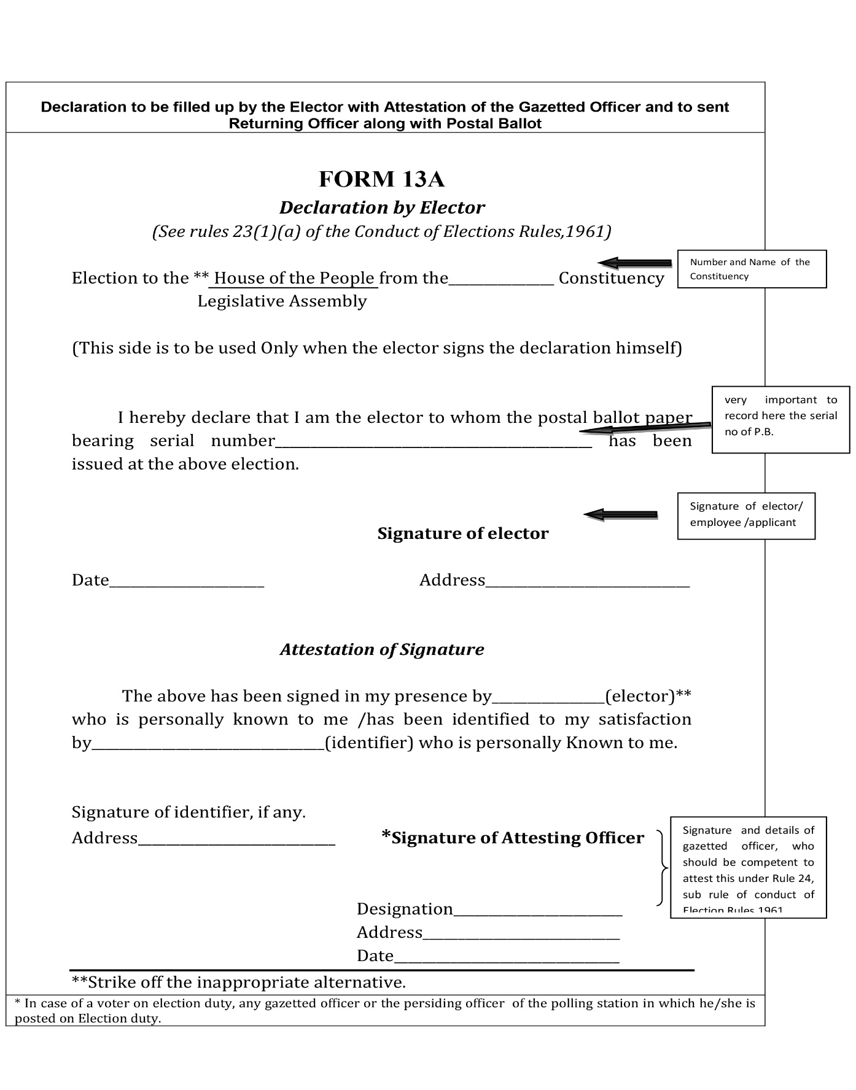
Form 13-A (Declaration)
Contd…

Slide 15
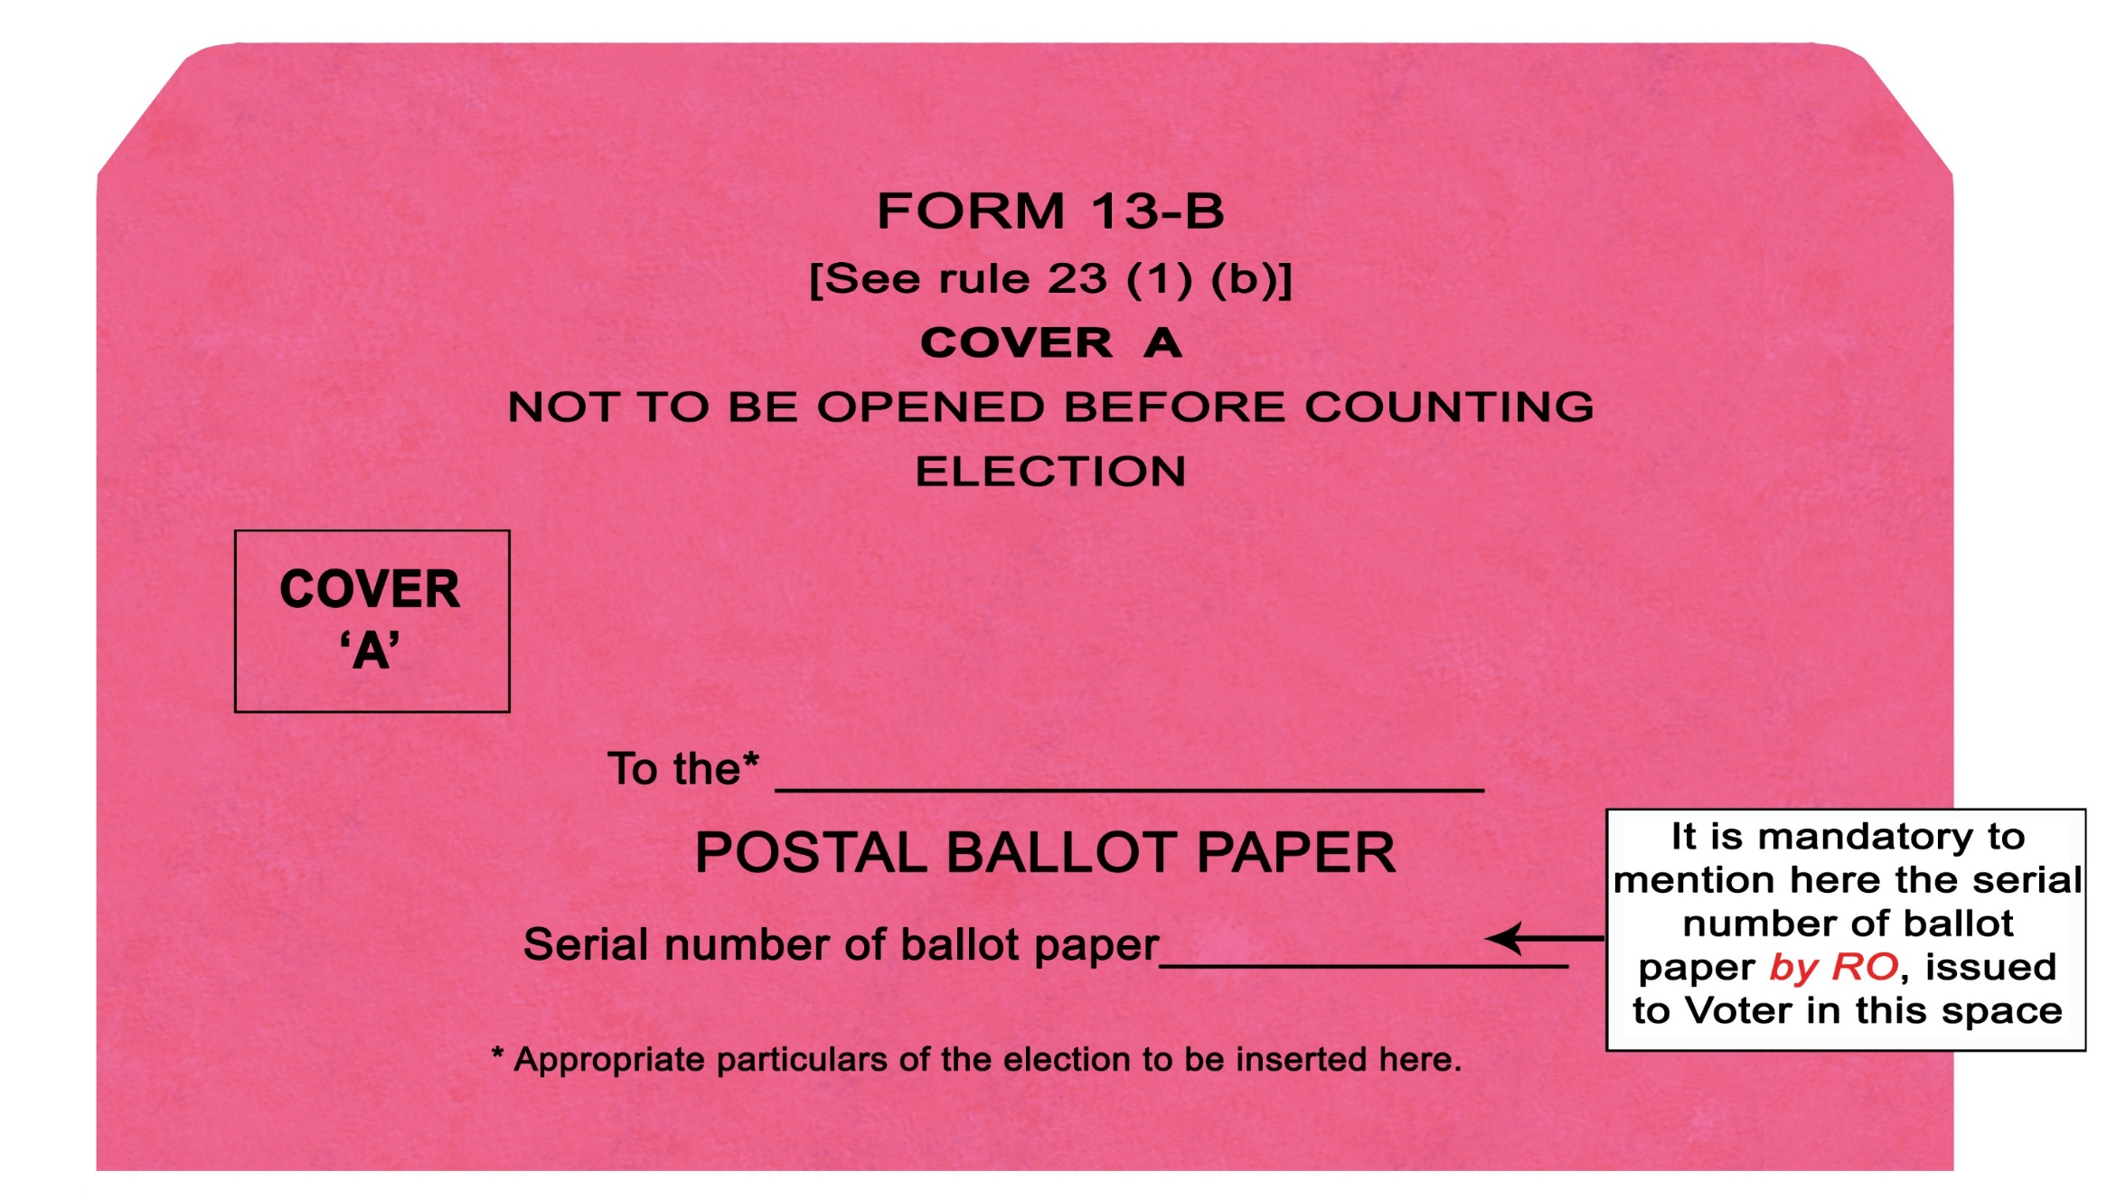
Form 13-B (Cover-A - inner)
Contd…

Slide 16
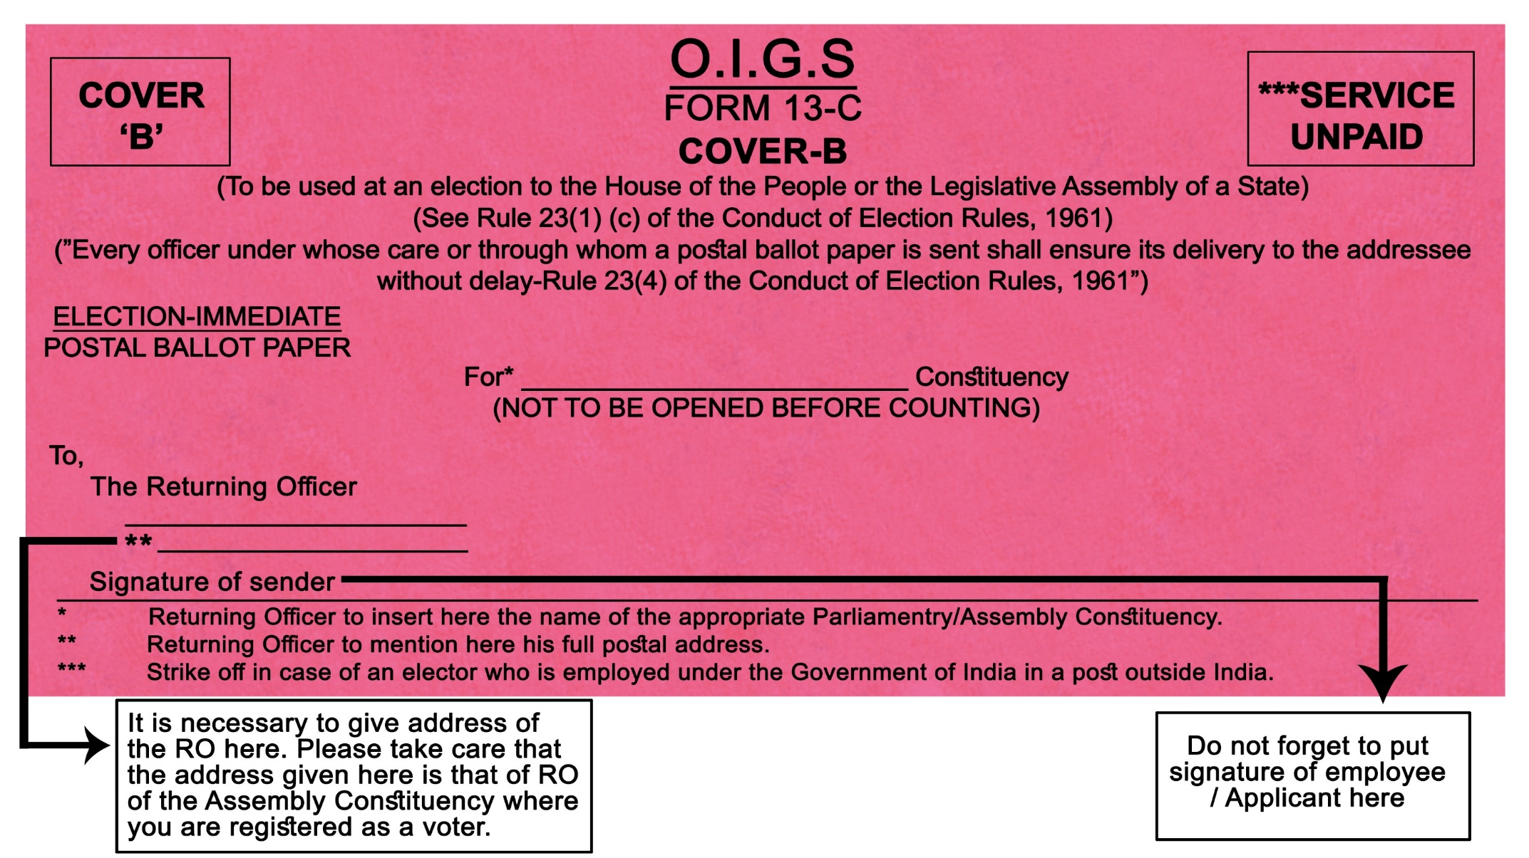
Form 13-C (Cover-B - outer)
Contd…

Slide 18
Intimation by Voters to Vote by Post
Timelines for intimation by entitled voters:
Service Voter- Intimation not required. RO automatically sends ETPBs to such voters
Special Voter & Voters on Election duty - Intimate/ apply to the RO in Form-12, in advance for issue of PB paper
- Form 12 A to apply for EDC, if deployed in same constituency
Intimation by Voters on Election Duty shall be at least 7 days before poll or such shorter period as decided by RO (R 20 COER, 1961)
Intimation by special voter at least 10 days before poll (R 19 COER, 1961)
Electors under Preventive Detention - Name and details are furnished by the State Govt. to the RO within 15 days of issue of notification (R 21 COER, 1961)
Notified Electors – Intimate/apply to the RO in Form 12D from the date of announcement of election until 5 days from the date of notification (S 60(c) RPA, 1951), R 18(a) COER, 1961
NB 1: Please carefully note the zero date for calculating the timelines in terms of either date of poll or date of notification
NB 2: PD - the detainee can also directly apply to RO for the Postal Ballot

Slide 19
Dispatch of PB (General Instruction)
Procedure for despatch of PB:
Send following documents (i) PB, (ii)Form-13A (Declaration), (iii) Form 13B (Inner Envelope) (iv) Form 13C (Outer Envelope) and (v) Form-13D (Instruction) NB: For Service Voters the above will be transmitted electronically through ETPBS
Record the electoral roll number (Part No. and Sl.No. as entered in the marked copy) on the counterfoil of PB
In the Marked Copy of the ER, PB in RED ink should be written against the names of all who have been issued PBs.
PB serial no. should NOT be written against the voter’s entry.
No PB can be issued after the stage of preparing marked copy of electoral roll for supply to the presiding officers for conduct of poll.
Contd…

Slide 20
General Instructions - Dispatch contd.
Steps to remember for preparing marked copy of ER -
PB serial no. should be written on Form 13-B (Cover A - inner cover) without fail.
NB: PB liable for rejection, if PB Serial number not mentioned
Classified Service Voter (CSV) should be marked in the Electoral Roll against the entries of the voters who have opted for proxy (R 27P COER, 1961)
EDC should be marked against the entries of voters to whom EDC has been issued.
Seal the counterfoils with proper description and date (R 23(6) COER, 1961)
Proper account of PB and EDC issued to be maintained in a Register.
The team entrusted with preparing Marked Copies of ER, may also be entrusted with issuance of PBs for better results/efficiency
Please note that only one Marked Copy should be used as a Master copy for issuing PBs to avoid any mistake.
Ensure that electors issued with PB are not allowed to vote at Polling Station
NB: The above are pointers are aimed at ensuring that electors issued with PB are debarred from voting at the Polling Station
Contd…

Slide 21
Dispatch - PB serial No. – DOs and DON’Ts – contd.
Where to be written/printed ?
On cover A (inner)– Form 13-B
On Form 13-A
On Counter foil of the PB
YES a
Where NOT to be written?
In Electoral Roll/Marked Copy
On any cover other than Cover A (inner) (Form 13-B)
NO r

Slide 22
Dispatch (transmission) of ETPB to Service Voters
Documents to be transmitted and timelines:
After publishing Form 7A, RO will prepare/generate and upload PB with connected papers through Electronically Transmitted Postal Ballot System (ETPBS).
Transmit following document electronically- (i) PB, (ii) Form-13A (Declaration), (iii)Label for Form 13B (Inner Envelope) (iv)Label for Form 13C (Outer Envelope) and (v) Form-13D(Instruction)
ETPBs are to be issued within 24 hours from the last date of withdrawal.
ETPB for the service electors will be issued/uploaded by the RO
DEO will appoint a suitable officer as the Nodal Officer to supervise the entire process of issuance of PBs to service electors.
Contd…

Slide 23
Dispatch (transmission) of ETPB to Service Voters – Contd.
Designating ARO for ETPBS and procedure to be followed:
Each R.O shall depute a team of officers including an ARO with details of Service Electors to whom PBs are to be dispatched on the basis of the last part of the electoral roll.
Mark "PB" against the entry of elector in the marked copy of last part of electoral roll.
Sr. No. of PB not be mentioned in the marked copy of last part of electoral roll.
Issue ETPB one by one. (There will be a QR code on every ETPB)
Contd…

Slide 24
Dispatch (transmission) of ETPB to Service Voters–contd.
Role of Observers in ETPB:
Senior-most Observer available in the District Headquarters shall personally monitor the entire process of dispatch of ETPBs.
The entire process must be videographed.
Observer to send a detailed report to ECI as soon as the dispatch of postal ballots meant for service voters is completed.
NB 1: Voters, who have been issued PB, are not entitled to vote in person at a Polling Station.
NB 2: Note the special role of Observer
NB 3: RO to ensure that all required particulars including NOTA are correctly entered in the Ballot before uploading the same
Contd…

Slide 25
Dispatch (transmission) of PB to Service Voters – contd.
Duties of ARO designated for ETPBS -
The ARO deputed to supervise the issuing of postal ballot papers to service voters shall ensure the following-
Write the letter PB against the entry of the elector in the marked copy of the electoral roll,
Proper account of PBs issued to service voters shall be maintained in an issue register.
The electoral roll part relating to service voter should be sealed and kept in RO’s safe custody.
Contd…

Slide 26
Dispatch (transmission) of ETPB - Sealing of Counterfoils and Marked Copy of Electoral Roll (R 23(2)(a) & (b) COER, 1961) – contd.
Counterfoils of postal ballots, issued, shall be sealed by RO in a packet.
Marked copy of last part of Electoral roll relating to service voters, to be sealed in separate packet.
Brief description of contents inside the packet with date of recording to be mentioned on both these packets and kept in safe custody of RO.
NB: These packets are to be transmitted to DEO for safe custody, after declaration of result.

Slide 27
Dispatch/ Issue of Postal Ballot to Special Voters (R 23(2)(a) & (b) COER, 1961)
Mode of delivery of PB to Special Voters –
PB may be delivered or caused to be delivered personally to a special voter in place of sending by registered post.
PB to be issued as expeditiously as possible.
Write "W" on the cover in Form 13 C (Outer Envelope) in case of female voter.
NB: Please note special marking for female voters

Slide 28
Notified voters -Absentee voters (S 60(c) RPA 1951, R 18(a) COER, 1961) – Process – applying - Distribution of Form 12D - dispatch to different categories – collection process of different categories – process of deposit – slides (27 – 40) w.r.t AVSC, AVPD, AVES and AVCO
Dedicated ARO for Absentee Voters
Sr. Citizen (above 80 Yrs) (AVSC), PwD Electors (AVPD), Voters on duty in Essential Services (AVES), Covid-19 infected electors (AVCO) are notified as absentee voters.
One ARO is assigned to handle all work related to PB voting by Absentee Voters. Such ARO will be responsible to carry forward the postal voting program from the stage of receipt of applications in Form 12D, and take all necessary action in this regard
NB: This is a new Category segregated for special voting facility after 2019 Lok Sabha election and hence it is possible that some CEOs/DEOs/ROs may be dealing with this category for the first time
Contd…

Slide 29
Process for applying for PB by absentee voters – Contd.
Timelines and documents required for Absentee Voters:
Intimation is given to ARO in Form 12D, giving all particulars in the form.
Intimation should reach the RO/ARO within 5 days from issue of notification.
In cases of Covid patients - Form 12D- should be accompanied by certificate/ instructions from competent health authorities.
In case of PwD voters, who opt for PB, From 12D, should be accompanied by Benchmark Disability Certificate issued by the competent authority.
Contd…

Slide 30
Absentee Voter - Distribution of Form 12D by BLO – contd.
Distribution and collection of Form 12 D:
Immediately after the announcement of elections, BLO will visit the houses of potential absentee electors (AVSC and AVPD) and deliver Form 12D and obtain acknowledgment.
BLO shall deposit all the acknowledgments with the RO.
If elector is not available, BLO will share his contact details and visit again.
The elector may or may not opt for PB.
If the elector opts for PB, then the BLO will collect the filled-in Form12D from the house of the elector within 5 days of the notification and deposit it with the RO
Sector Officer shall supervise it under the overall supervision of RO.
NB 1: The above is a checklist of role BLO w.r.t Absentee Voters. Please note that AVPB is an option available to those who can’t visit the polling station due to their physical condition. The ECI policy is to encourage all voters to come to polling Station. Hence, adequate publicity through SVEEP should be made about facilities such as wheelchair, volunteers, ramps, sign language etc. provided at the Polling Station
NB 2: Please note that timelines in relation to announcement of elections and notification of elections
Contd…

Slide 31
Absentee Voters - Role of RO in dispatch of PB – contd.
Preparation of list of Absentee Voters and issue of PB by RO:
On receipt of Form 12D, RO will draw a list of all Absentee Voters in the 4 categories, i.e. (a) ‘AVSC’, (b) ‘AVPD’ (c) AVCO and (d) AVES whose applications have been received in time and are in order.
All the electors, whose particulars are found correct shall be issued PB as Absentee Voters
Contd…

Slide 32
Absentee Voters - Role of RO in dispatch of PB to COVID 19 suspect or affected persons – contd.
Special procedure for AVCO cases:
The RO on being satisfied about the genuineness of the application, issues the PB to the AVCO concerned
The RO to make arrangement to deliver PB and to get the same collected back before the date fixed for poll in the Constituency.
The RO shall check certificate of competent authority, duly appointed by the State Government/UT administration to the effect that the elector is under home quarantine or institutional quarantine due to COVID-19.
Indicate entry ‘PB’ in the marked copy without recording therein the Sl. no. of the ballot papers issued to them.
The RO shall ensure that such elector is not allowed to vote in Polling Station
NB: Please refer to ECI’s instructions vide No._______/Dated______
Contd…

Slide 33
Absentee Voters - Sr. Citizen and PwD - dispatch of PB - Role of RO – contd.
Sharing Absentee Voter list and schedule of visitation with candidates:
RO shall share list of all such PwD and 80+ electors, whose applications in Form 12D for availing PB facility have been approved by him, with the Contesting Candidates in printed hardcopy.
NB 1: Complete transparency is vital and therefore must be ensured
NB 2: Candidates/agents have a right to know the schedule of visitation of mobile polling parties and to accompany them. However, under no circumstances can the secrecy of the vote be violated.
NB 3: It should be ensured that the voter is not exposed to any influence or intimidation.
Contd…

Slide 34
Absentee Voters - Process of collecting PB from AVSC, AVPD, AVCO electors – contd.
Constitution of Mobile Polling Teams:
Separate teams of poll officers, comprising two officials be formed.
At least one not below the rank/level of the official appointed as polling officer for PS.
No. of teams of Polling Officials to be appointed depend on the number of such Absentee Voters.
The team shall visit the electors at the address mentioned in Form 12D for facilitating their voting by PB paper.
Each team be provided with the list of AVSC, AVPD and AVCO electors, adequate number of postal ballot papers, envelopes, pen, ink-pad (for thumb impression wherever required), canvas bag etc.
NB: Candidates/agents have a right to know the schedule of visitation of mobile polling parties and to accompany them. However, under no circumstances can the secrecy of the vote be violated. It should be ensured that the voter is not exposed to any influence or intimidation.
Contd…

Slide 35
Absentee Voters - Process of collecting PB from AVSC, AVPD, AVCO electors – contd.
Other persons accompanying Mobile Polling Team:
Police Security cover shall be provided to the poll officers for their visits.
Videographer should accompany the poll officers who shall record the proceedings at the electors house without violating the secrecy of vote.
Visits by teams of poll officers should be completed by 1 day prior to the date fixed for polls
Authorized Media Personnel, if any, accompanying the poll team are also required not to breach the secrecy of ballot
Candidates and their agents, if any, accompanying the poll team are also required not to breach the secrecy of ballot
Appropriate protection equipment including PPE kit for the poll officers going to COVID-19 infected electors home. This should be done in consultation with the Nodal Health Officer for AVCOs.
Contd…

Slide 36
Absentee Voters - Process of collecting PB from AVSC, AVPD, AVCO electors – contd.
Intimation of schedule of visitation of Mobile Polling Teams:
Intimate electors, in advance, date and approximate time of visit of Poll Team through SMS. If mobile no. not available, intimation be given by post and /or through the BLO.
If elector is not present at the 1st visit, the team shall leave intimation about the time of 2nd visit. If the elector is not present even at the 2nd visit, no further visit or action required.
Inform candidates about schedule of visit for the delivery and collection of PB. They may depute their authorized representatives, with prior intimation to the RO.
Contd…

Slide 37
Absentee Voters - Process of collecting PB from AVSC, AVPD, AVCO electors – contd.
On-site procedure during visitation before handing over PB:
The POLL Team shall ascertain the identity of the elector before issuing PB
Name of elector and the document produced for identification be entered in a register and signature/thumb impression of the elector obtained therein.
A tick mark shall be placed against the name of the elector in the list of AVSC, AVPD and AVCO to indicate that the person has voted.
NB: Compliance to the corresponding instruction in respect of AVCO must be ensured
Contd…

Slide 38
Absentee Voters - Process of collecting PB from AVSC, AVPD, AVCO electors – contd.
Briefing of voter regarding Form 13 A, B & C procedure:-
Making declaration in Form 13A and getting it attested by the poll officer himself
Entering sr. number of PB paper, both on Form 13A and on the smaller envelope (Form 13B)
Manner of marking vote, folding and placing the marked ballot in the smaller envelope and closing the envelope
Placing the declaration in Form 13A, duly filled up, signed and attested along with closed envelope (Form 13B) containing the marked ballot paper inside the larger envelope (Form 13C), Closing the larger envelope and handing over the same to the poll officer.
NB: Please ensure that during training the polling team is clear about the sequence of statutory declaration, of marking, folding and closing of Ballot Paper and envelops
Contd…

Slide 39
Absentee Voters - Process of collecting PB from AVSC, AVPD, AVCO electors – contd.
On-site process for recording of vote:
The counterfoil with the serial number and part number of elector duly filled up shall be got detached and kept in safe custody by the team.
Poll team will -
issue PB to Voter
Brief about procedure to be followed for voting through PB
Make sure that the elector votes without anyone influencing his/her choice, and ensuring the secrecy of voting
If any elector is not able to cast vote by himself due to blindness or physical infirmity, he/she be allowed to take the assistance of any adult person for casting vote.
Videography of above all activities/steps at the address of the elector concerned is mandatory
Contd…

Slide 40
Absentee Voters - Process of collecting PB from AVSC, AVPD, AVCO electors – contd.
Attestation of Declaration(Form 13A) and collection of PB:
Poll officer is authorized by ECI to attest the declaration in Form 13A. While attesting the declaration, the poll officer shall write his full name and also the designation ‘poll officer’.
In the case of a COVID affected person on treatment in Hospital, the MO attending to the person also authorised to attest the declaration.
After vote is cast on PB and envelope in Form 13C is ready, the Poll Officials will collect the same.
Contd…

Slide 41
Absentee Voters - Process of Deposit of PB from AVSC, AVPD, AVCO electors – contd.
Delivery and safe custody of polled PBs and record – maintenance:
At the end of each day of visit by poll team, (i) envelopes in Form-13C containing postal ballot paper etc. and (ii) counterfoils of PB shall be collected by the ARO designated for this purpose.
The ARO shall make arrangements to have the same delivered at the HQ of the RO for keeping them in safe custody.
The ARO shall maintain the record indicating the number of ballots sent on each day. This should also be shared with the RO on a daily basis.
Contd…

Slide 42
Absentee Voters - Guidelines for Voting through postal ballot by Absentee Voters on Essential Service (AVES) – Application, verification, issue of PB – voting in PVC – timelines – intimation to candidate - Declaration in Form 13A - close of poll– making of packets – sealing - (slides 41 – 47)
Application for PB by AVES through Nodal Officer:
Absentee Voters on Essential Service (AVES) has to make application to RO in Form-12D giving all requisite particulars.
Their application (Form 12D) should be verified by the Nodal Officer appointed by the organization concerned.
Form 12D should reach the RO within five days of notification of the election.
Contd…

Slide 43
Absentee Voters - Guidelines for Voting through postal ballot by AVES – contd.
Verification of application, listing of AVES and marking PB in ER by RO:
On receipt of Form-12D, the RO shall verify their names with the existing electoral roll and prepare a list of all AVES whose applications have been received in time and are in order
The RO shall thereafter arrange to issue PB to them at Postal Voting Centers (PVCs), to be specially setup for voting by AVES
After the list of this category is finalized, entry ‘PB’ shall be made in the marked copy of the electoral roll against the names of such electors.
Contd…

Slide 44
Absentee Voters - Guidelines for Voting through postal ballot by AVES – contd.
Setting up of PVC and intimation of details to AVES:
The RO will set up a Postal Voting Centre (PVC) to be used as the place for issuing of PB paper and for facilitating their voting and for collection of the PB paper.
AVES shall be duly intimated about the (i)The full address of the PVC venue where PB ballot voting is to be arranged ; (ii)Dates on which the PB voting facility will remain open;(iii) The hours fixed for postal ballot voting.
They may come for casting vote on any of the three days during the hours fixed for the purpose and service identity card is must for identification.
Those who have been approved for voting though this facility can only vote at such PVCs and not in any other manner
Contd…

Slide 45
Absentee Voters - Guidelines for Voting through postal ballot by AVES – contd.
Intimation to candidates, personnel and SOP at PVC:
Candidates to be given prior intimation about PVC by RO. They may appoint agents for watching the proceedings in the PVC.
Appropriate number of staff may be appointed for PVC. Each centre should have at least one gazetted officer for attesting the declaration of elector in Form-13A.
Identity be verified before issuing PB paper. Name and document produced for identification be entered in a register and signature/thumb impression be obtained.
A tick mark be placed against the name of the elector in the list of AVES.
The counterfoil with the serial number and part number of elector duly filled up shall be got detached and kept in safe custody to be sent to the RO along with envelopes containing polled postal ballots.
Declaration in Form 13A will be attested by the gazetted officer present in the PVC
After closing the large envelope, the voter will drop it in the box kept in the PVC.
Contd…

Slide 46
Absentee Voters - Guidelines for Voting through postal ballot by AVES – contd.
Schedule for Voting at PVC:
After closing the large envelope, the voter will drop it in the box kept in the PVC.
PVC shall be open for up to three consecutive days in each of the constituencies.
The three days period shall be so fixed that it is completed at least 3 days before the date fixed for poll in the constituency.
On each of the three days, the PVC shall remain open from 9 AM to 5 PM
Contd…

Slide 47
Absentee Voters - Guidelines for Voting through postal ballot by AVES –close of poll– contd.
Daily end-of-poll procedure at PVC:
On each day after the poll closes, the envelopes in Form 13C in the drop box shall be taken out, and sealed in a larger packet superscribed “Postal Ballots in PVC”. On the outer packet, the following particulars should be clearly mentioned:
Name and number of Constituency,
Name of location of PVC,
The date on which the votes were cast,
The number of envelopes in Form 13C in the packet.
Contd…

Slide 48
Absentee Voters - Guidelines for Voting through postal ballot by AVES –close of poll– contd.
Sealing of counterfoils, sending packets of polled PBs and other materials to RO
The counterfoils of PB shall also be sealed in a separate packet super-scribed “Counterfoils of PBs in PVC”.
Both the packets containing the polled PBs and the counterfoils be sent to the RO in same evening.
Signature of the agents of candidates present in the PVC should be obtained on each day of voting in the PVC.
At the end of the 3 days voting period, all other material supplied to the PVC be collected by the ARO in charge of the PVC and retained at the HQ.
If any AVES does not turn up for voting in PVC, there is no requirement of sending the PB by post.
NB: The mode of voting prescribed for AVES is voting at PVC only .

Slide 49
Voters on Election Duty - Issue of PB – eligibility – printing – application – database - Facilitation Centre - Drop Box - design thereof – Sorting AC-wise – presence of representatives of candidates - Account Register – sealing in envelopes and dispatch to RO (slides 48- 54)
Preparation of database of employees working in the district:
Every district has to prepare a database of all Govt. Employees posted in the district for the purpose of deploying them on election duty.
Include all employees of State Govt., Central Govt. and Central and State PSUs., all police personnel posted in the district including Home Guards etc. and drivers, conductors and cleaners of Govt. vehicles, vehicles of State Road Transport Corporation etc. in the database.
Include drivers, conductors and cleaners of private vehicles in the district like trucks, buses, minibuses etc. with the help of vehicle owners associations.
All electoral information of the employees – like complete residential address where the staff is enlisted in the electoral Roll, No. & name of Assembly Constituency, Part No. and the serial number at which the name is registered, EPIC No., and Cell Phone numbers and email Ids etc. needs to be incorporated in the database.
Contd…

Slide 50
Voters on Election Duty - Issue of PB/EDC – contd.
Application for PB/EDC and issue of PBs/EDCs
Issue call letters for training along with pre-printed Forms 12 or 12A , requesting employees to bring signed applications in Form 12 (for PB) or Form 12A (for EDC) on the date of the first training.
RO should keep ready PB or EDC (in Form 12 B) , as the case may be, for issue to eligible employees at the time of training.
One officer should be deputed by RO for issue of PB and to maintain an account thereof.
PB papers not issued in the first training, the same shall be issued during subsequent trainings.
If any official who submits Form 12 and for whom PB has been prepared does not collect the PB paper personally at the second/subsequent training at the facilitation center, the PB for such person should be dispatched by Registered Post with A/D within 24 hours.
RO should
NB 1: No PB prepared for issue should remain unissued with the RO/any other official.
NB 2: The EDC applies only in the case of officials on duty in the same constituency in which they are enrolled
Contd…

Slide 51
Voters on Election Duty - Issue of PB – contd.
Facilitation Centers – arrangements to be made:
Postal ballot papers shall be distributed to the polling officials at the second round of training after verification of ID.
A Facilitation Centre with Drop Box shall be opened for issuing PB, facilitating voting and collection of PB from polling personnel at the training venue during all training sessions.
One or more Gazetted Officers, depending on requirement, shall remain present at the Facilitation Center for verification/attestation of declaration in Form 13A.
Separate time should be allocated in the training for explaining the procedure of marking and depositing of postal ballot papers.
Time should be granted during the training, for employees to fill up declaration in Form 13A, verification by Gazetted Officer, marking of postal ballot, and depositing of postal ballot in the Drop Box.
Contd…

Slide 52
Voters on Election Duty – Voting at Facilitation Centre – contd.
Conduct of PB voting at facilitation center and sealing of Drop Box
Voting compartments similar to voting compartments in PS shall be provided in each Facilitation Center.
This is done so that employees are able to mark their PB in complete secrecy. More than one such voting compartment can be provided if necessary. Arrangement of glue/gum shall also be made to seal the envelopes.
A large steel trunk with one opening at the top for casting of PB shall be used as Drop Box at the facilitation center.
Before the casting of postal ballots is started the empty Drop Box will be opened and shown to all present.
The Drop Box will then be sealed by the officer in-charge of the Facilitation Center.
NB: Every voter shall cast his or her PB in the Drop Box after marking it and sealing it in the envelopes.
NB 2: Candidates are permitted to appoint their agents to watch the voting process, at the facilitation canter. ROs shall intimate the candidates about the schedule of the facilitation centre in advance

Slide 53
Voters on Election Duty – Sorting of Postal Ballots
End-of-poll procedure at facilitation center on each day:
After all postal ballots for the day have been cast; the drop box will be opened by the officer in-charge of the Facilitation Center in the presence of the representatives of candidates, who may be present.
All the postal ballots will be taken out of the box and the empty box will be shown to the said representatives of political parties.
The postal ballot envelops will be sorted Assembly Constituency wise and the number of postal ballot envelopes received for each Assembly Constituency will be entered in a register in Format-1 (ECI Instruction) to be maintained for this purpose at the facilitation center.
Contd…

Slide 54
Format-1:
Account Register Of Postal Ballot Papers Issued to Persons Drafted For Election Duty
Number and name of the Assembly Constituency::___________________________ Date of Training Session at which facilitation centre was provided____________________ (if there are more than one date, information may be maintained separately for each date) Place of facilitation Centre________________________________________________________
Running Sl. No. | Part No. of electoral roll | Sl. No. of elector in the electoral roll | Details of the document produced by the elector in proof of his / her identification | Signature / T.I. of elector | Remarks
1 | 2 | 3 | 4 | 5 | 6
Contd…

Slide 55
Voters on Election Duty – Sorting of Postal Ballots – contd.
AC-wise sorting of polled PBs and dispatch to ROs
Representatives of candidates present will be requested to put their signatures on the register and will be given a copy of the relevant pages of the register.
All postal ballot envelopes for one AC will be kept in a large envelope meant for that AC. The name of the Facilitation Centre, the date of Facilitation and the number of PBs contained therein will be clearly written on this envelope.
This envelope will then be sent to RO of the concerned AC along with a copy of the relevant pages of the register through special messenger appointed by RO for this purpose not below the rank of Deputy Tehsildar.

Slide 56
Voters on Election Duty – PB for Police Personnel on Poll Duty
Legal Provisions regarding police personnel on poll-duty:
During election period, all police personnel of the State, from constable to DGP, are notified under S 28A RPA, 1951 as on deemed deputation to ECI. Therefore, all police personnel, except those on leave during the election period, are treated as personnel on election duty and hence entitled to vote by PB.
Have to submit application in Form-12 for availing the facility of PB.
Contd…

Slide 57
Voters on Election Duty – PB for Police Personnel on Poll Duty – contd.
Arrangements to facilitate PB voting by police personnel:
RO to ensure issue of PB to all police personnel whose application in Form-12 are received in time through SP. This can be combined with training of police officials on poll duty.
SP should then organize a special Facilitation Camp for police officers on poll duty for casting postal ballots.
One Gazetted officer should be deputed for attestation of the Form of Declaration in Form-13A made by elector to whom PB is issued.
Register should be maintained to keep correct account of PBs issued.
A drop box shall be kept at the Facilitation Camp and police officers who have been issued postal ballot should be told to deposit postal ballot in this box after marking them.

Slide 58
Voters on Election Duty – Postal Ballot for Drivers/ Conductors/Cleaners
Nodal Officer to facilitate application for Postal Ballot for Drivers/ Conductors/Cleaners
DEO to appoint a Nodal Officer for requisitioning of vehicles for poll duty. It shall be the duty of the Nodal Officer to collect Information needed to issue PBs to drivers /conductors / cleaners of requisitioned vehicles who shall collect information from Vehicle owners about No. and name of Assembly Constituency, EPIC no. and serial no. in electoral roll, no. and name of polling station where he is enrolled.
Drivers/ Cleaners should bring their EPIC when they report for duty.
One Officer well trained in the process of elector search should be deputed.
From the EPIC details, information regarding complete address, No. and name of AC, Electoral Roll part no. where he is enrolled should be entered in a register. He may also use search facility.
The Nodal Officer shall get the signature of Drivers/ Cleaners/ Conductors in Form-12 and send to RO at least 7 days before poll date, so that the RO issues PB to them and make the entry of “PB” in the marked copy of the roll.

Slide 59
Register of ALL Postal Ballot Papers
Maintenance, Sealing and safe custody of Register of all PB papers
A separate register to keep a record of issue of PBs to all categories and PBs received back should be maintained (no specific format provided by ECI)
The register should be sealed in the same manner as the Register of Voters in Form 17A used in polling stations.
It should be kept along with other statutory covers mentioned in R 93 (1) COER, 1961.
Copy of this register can be given to the candidates who demand for it after the date of poll in the constituency.
NB: This Register needs to contain an account of ALL PBs issued to ALL categories of electors (Service, Absentee, Election Duty, Special, Preventive Detention and other notified categories, if any and, etc.)

Slide 60
ALL Postal Ballot Papers – Return - Procedure on Receiving Postal Ballots by Post
SOP for daily receiving of PB from Postal Dept.
Details of total no. of postal ballots delivered by the post office everyday will be shared with the representatives of candidates.
Acknowledgement of the number of postal ballots received by post will be prepared in duplicate. One copy to be given to the post office and other copy shall be kept in the record of the RO.
The number of postal ballots received will be entered in the daily return in Format-3 by the RO (ECI Instruction - L. No. 52/2014-SDR dated 07/03/2014).
The entire process will be videographed.
NB: RO to make meticulous arrangements for ensuring compliance as above

Slide 61
Return of Polled PB - Role of CEO/RO
Arrangements for flawless delivery of returned PBs till start of counting:
For receiving back postal ballots by post, the CEO will make arrangement with the Postal Department to nominate one post office for each Assembly Constituency which will deliver postal ballots every day to the Returning Officer.
The time of delivery will be fixed at 3 PM every day at the office of the Returning Officer, except for the counting day when the time for delivery will be at the counting center for that Constituency till the start of counting.
NB: A pass should be issued to the nominated postal department employee to enter the counting center on counting day for this purpose.

Slide 62
Monitoring of ALL Postal Ballots Received from facilitation Centers
Monitoring and reporting of returned PBs in Format 3 on daily basis:
RO will prepare a return of the PBs received from facilitation centers in Format-3 every day till he stops receiving postal ballots from facilitation centers.
(The number of PBs received by post will also be entered in the Format-3 till the day of counting)
A copy of the return in Format-3 to be forwarded to the Chief Electoral Officer every day through the DEO of the District.
A copy of the return in Format-3 will also be given to all the candidates.
The Chief Electoral Officer will compile the information of the State in Format-3 every day and transmit a copy to the ECI. The CEO will also send a copy of the compiled Format-3 to all recognized political parties.

Slide 63
Storage of ALL PBs Received by post – process flow
Keep all PBs received from post office every day in a separate envelope.
Write “Postal Ballots received by post” and the date on the envelope.
The daily return of PBs received to be sent to the CEO through the DEO.
Keep the envelope for each day in the strong room.
The CEO to compile information of the State every day and send a copy to ECI and also to all recognized political parties.
The RO will keep all postal ballots received from the post office every day in a separate envelope for that day and write on the envelope the date and words – “Postal Ballots Received by Post”.
He will keep this envelope also in the strong room for postal ballots every day after the post has been received.

